Slide 1
Electrical vehicles sales in indian
Yearly Report

Slide 2
Content
Project Title
Data from SQL
Objective
Tool Used
Dashboard & insights
Link

Slide 3
Objective
.
India’s electric vehicle (EV) market has witnessed significant growth over the past few years, driven by environmental concerns, government incentives, and technological advancements. In FY 2023–24, the country recorded over 1.6 million EV sales, marking a substantial year-on-year increase. The majority of these were electric two-wheelers and three-wheelers, which together accounted for over 90% of total sales, largely due to their affordability and suitability for urban commuting and last-mile delivery.
Government initiatives like the FAME II scheme, state-level subsidies, and increasing fuel prices have further accelerated the shift towards electric mobility. Leading players in the Indian EV space include Tata Motors, Ola Electric, Ather Energy, and TVS, among others. While the market is expanding rapidly, challenges such as limited charging infrastructure and high battery costs remain.

Slide 4
Tool Used
1.Data Import & Integration
Get Data -Import data from CSV, databases
Power Query Editor-Clean, filter, and transform raw sales
Data Types-Format columns (Date,Text, etc.)
2.Data Modeling
Relationships- Link tables like Sales,Category, Subcategory,city.

Slide 5
3. DAX (Data Analysis Expressions)-Used to create KPIs and calculated measures: Measure Example DAX Formula Total Sales = SUM(Sales[Total Price])
4. Data visulazation -
Line Chart | Sales by Year
Bar/Column Chart | year by category, monthwise
Donut/Pie Chart Slicer | year By types, class month
KPI Cards | Count State and sales
:

Slide 6
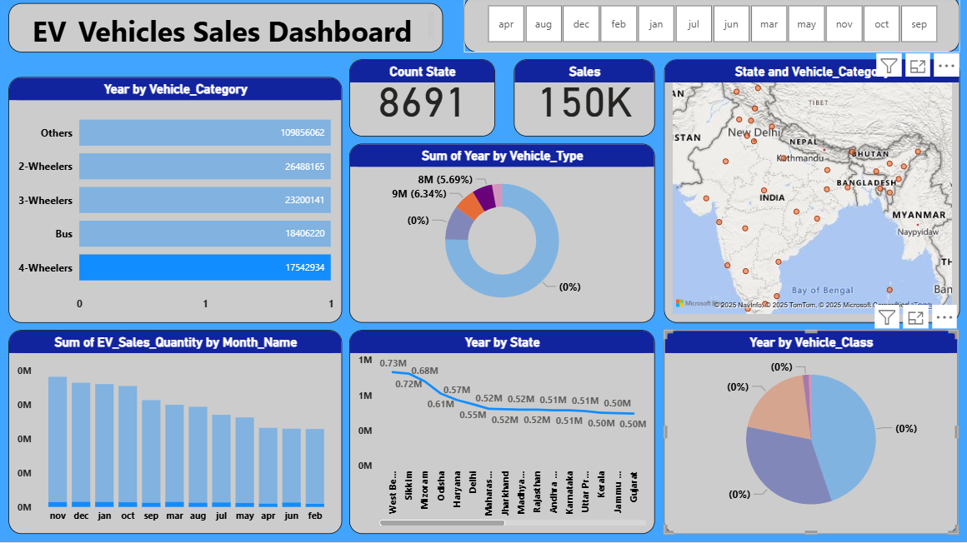
Output

Slide 7
Insights
Total sales - 150K
Count State - 8691
Avg Sales Quantity - 13.6
Vehicle Type others hight sales - 9107613

Slide 8
Link
https://github.com/manisharahul/Electric-vehicles-sales-in-indian/upload/mai
https://github.com/manisharahul/Electric-vehicles-sales-in-indian/upload/main
https://github.com/manisharahul/Electric-vehicles-sales-in-indian/upload/main

